Slide 1



Slide 2

Smart Bank Locker based on Iris Recognition
Supervised by:
Dr Muhammad Sharif
Group Members:
Azmat Hayat( SP17-BCS-006 )
Faisal Ameer(SP17-BCS-007 )
Presented on Dec, 2020
Department of Computer Science
COMSATS University Islamabad
Attock Campus

Slide 3
Outline
________________________
Introduction
Problem statement
Objectives
Related Work
Methodology
Functional/Non-Functional Requirements
Tools and technologies
Diagrams
System Screenshots
Conclusion and Future Work
_______________________________

Slide 4

Introduction
Image Processing/Machine learning involved in everything. Each person wants comforts in life with improvements in his/her productivity.
Everyone wants perfection in duties.
A lot of work has been started in image processing and face recognition and detection systems have been developed

Slide 5
Continued...
We are developing an Iris recognition security system for bank locker that is capable to secure bank lockers from illegal access.
It will reduce the threat of misuse and traditional key locks approach.
The system use camera to capture bank employee eye iris image. It consist of database of employee that hold eyes images and its personal information.

Slide 6
Problem Statement
Some companies and institutes that are using fingerprints for security purpose and PIN but we can’t rely on one system.
Being the internal organ of the eye, Iris is highly protected
We used iris recognition for security purpose.

Slide 7
Objectives
The main aims and objectives of our system are
as under :-
Improve the security of bank lockers.
Bring automated security system and allow user fast and secure access to their lockers account

Slide 8
Continued...
To get rid of traditional keys and locks for security purpose.
Overcome security issues.
Improve user feasibility by adding biometric system

Slide 9
Related Work / Applications
Name | Weakness | Proposed system solution
Fingerprints | Damage, scratches or sweating | As iris is well protected behind the eyelid, so it has less chance of damage
Face Recognition | scratches or sweating or any other change Female cover the face in our society they need to uncover | But Iris remain same with age hence it has no effect. It overcome face cover problem.

Slide 10
Methodology
Build on the base of Iterative model.
At each iteration, new functional capabilities are added.
At each iteration, the performance and accuracy measure and increase.

Slide 11
Functional Requirements
1 Bank Manager Account
Register to access main locker room
Access main locker room to provide access to other users to their respective lockers.
2 Bank Locker User Account
Register to access locker.
Login to open their respective locker for personal use.

Slide 12
Non-Functional Requirements
Security
Validations
Usability
Performance
Availability
User Friendly

Slide 13
Tools and Technologies
Tools | Rationale
PyCharm | IDE
MS Word | Documentation Work
MS Power Point | Presentation Work
Python | Back end language
Tkinter | Interface Designing,
Python Pickle File | Storage, objects serializer

Slide 14
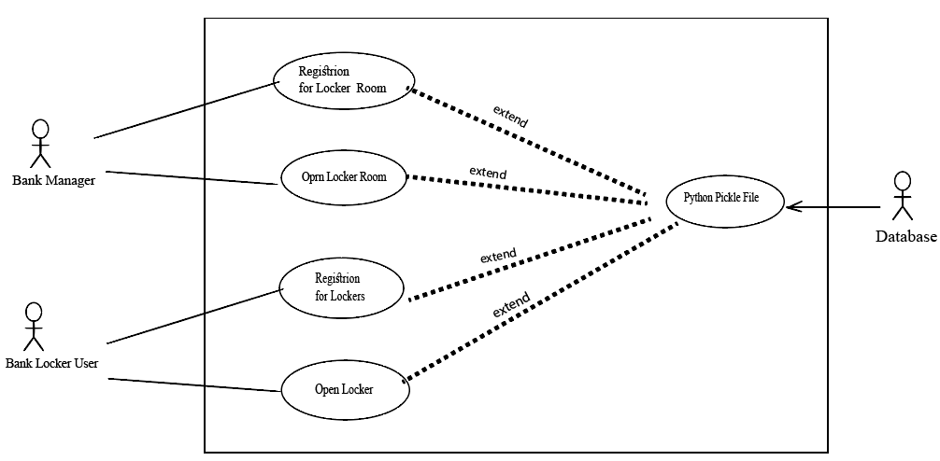
Use Case Diagram

Slide 15
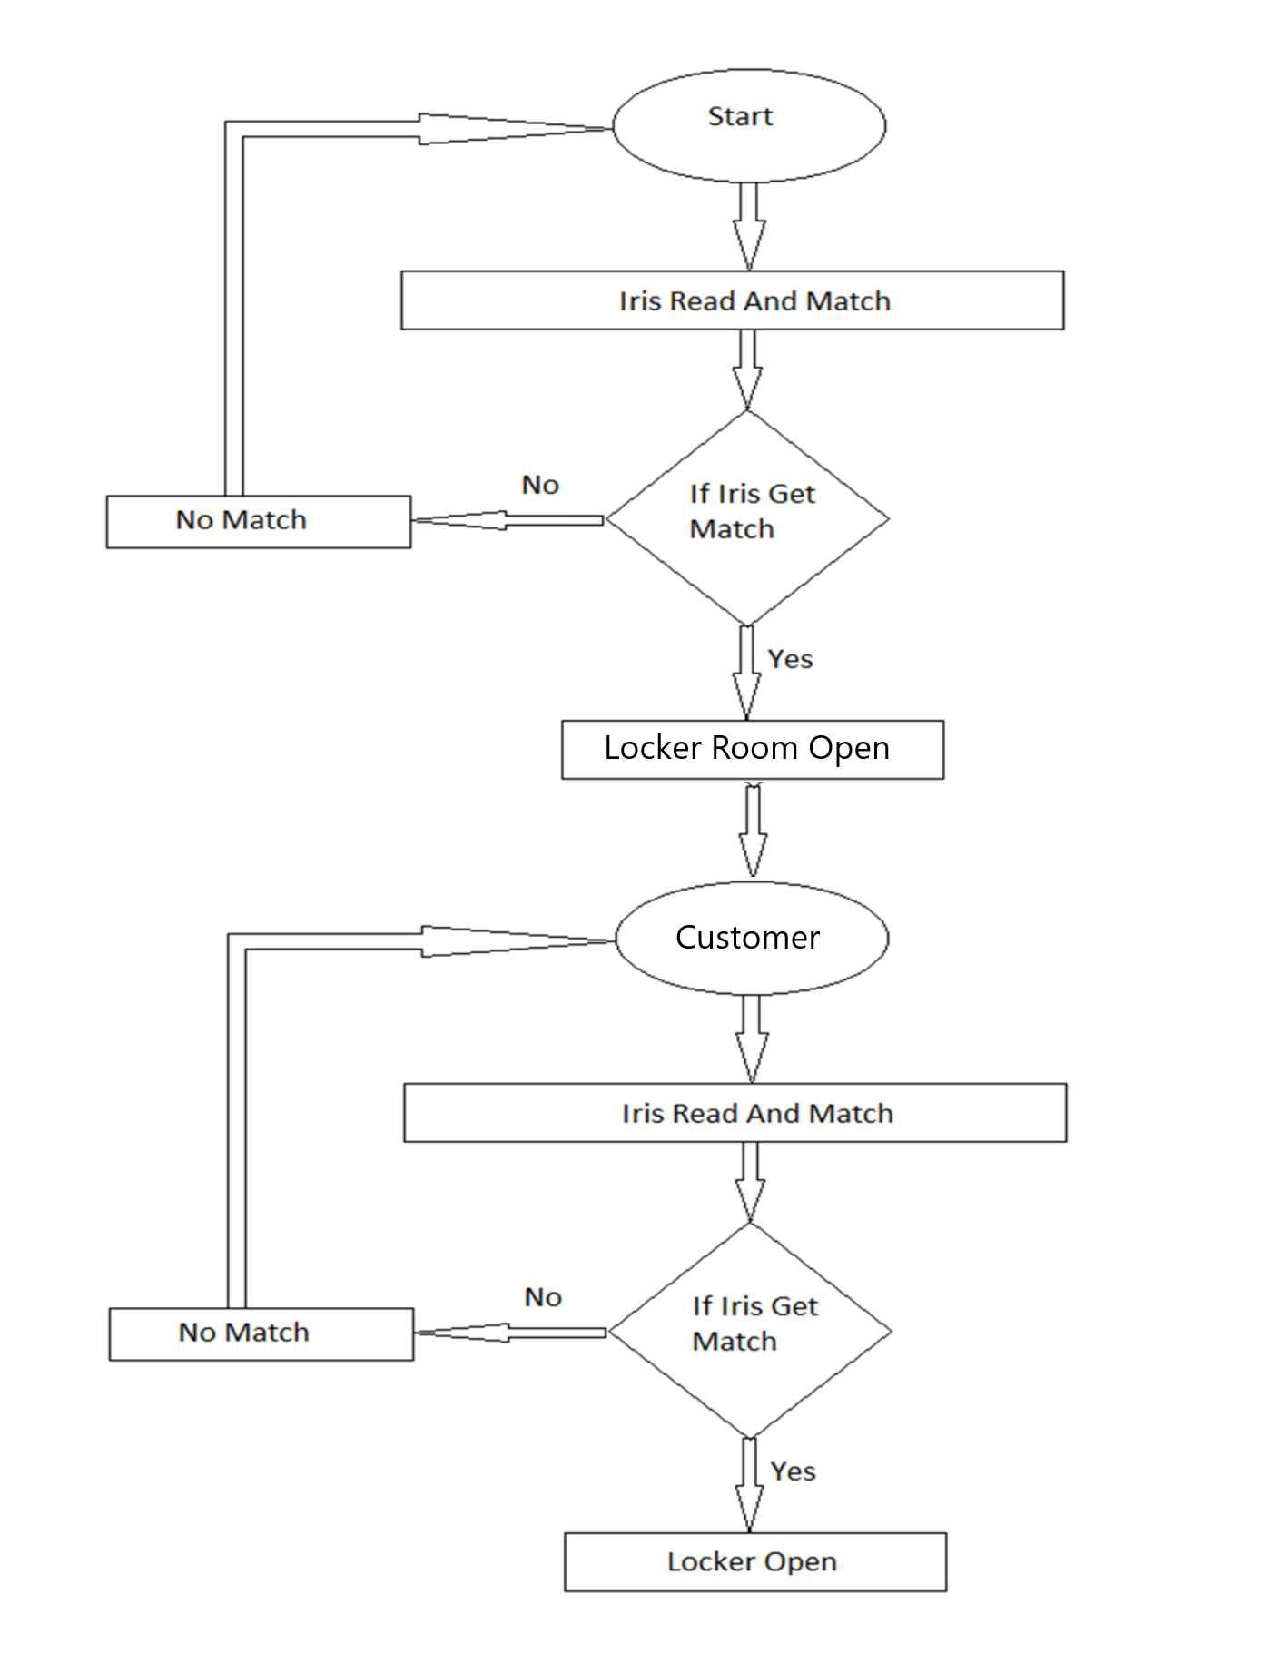
Activity Diagram

Slide 16
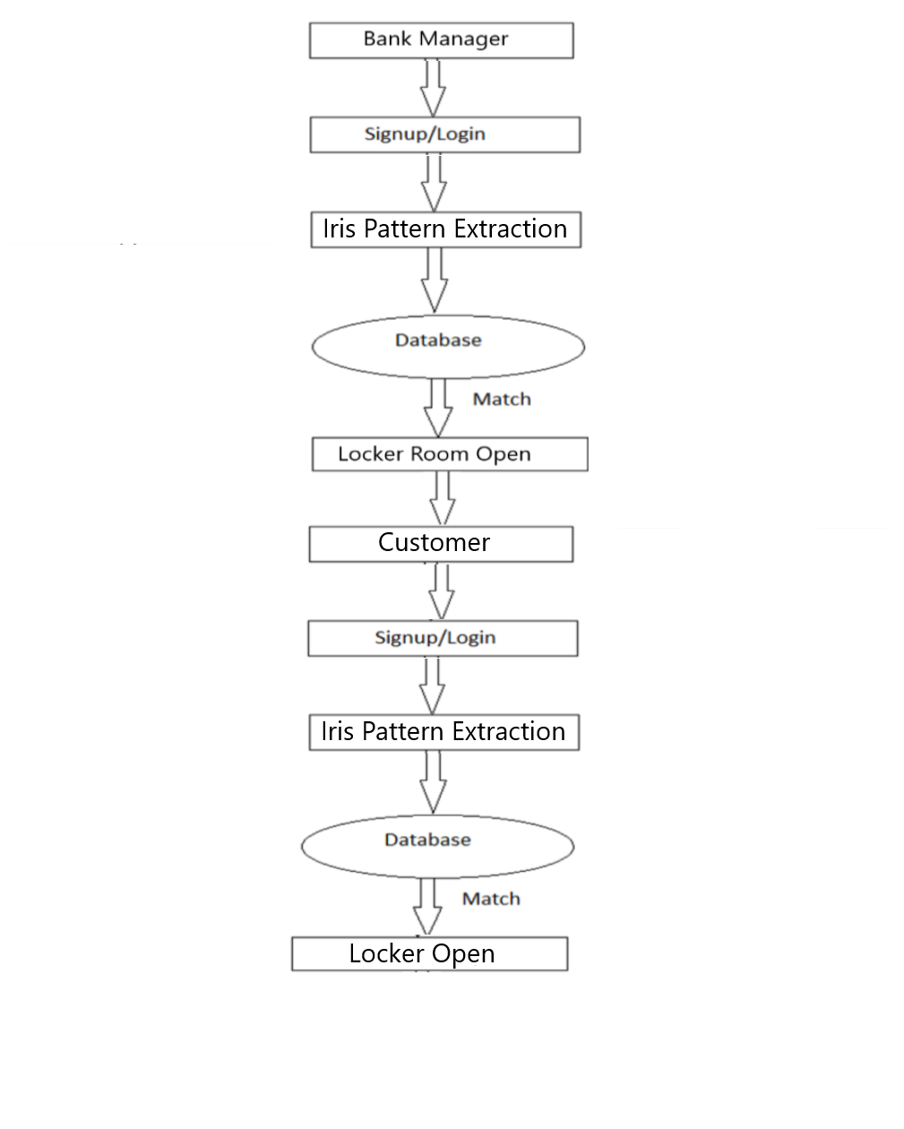
DFD (Level 0)

Slide 17
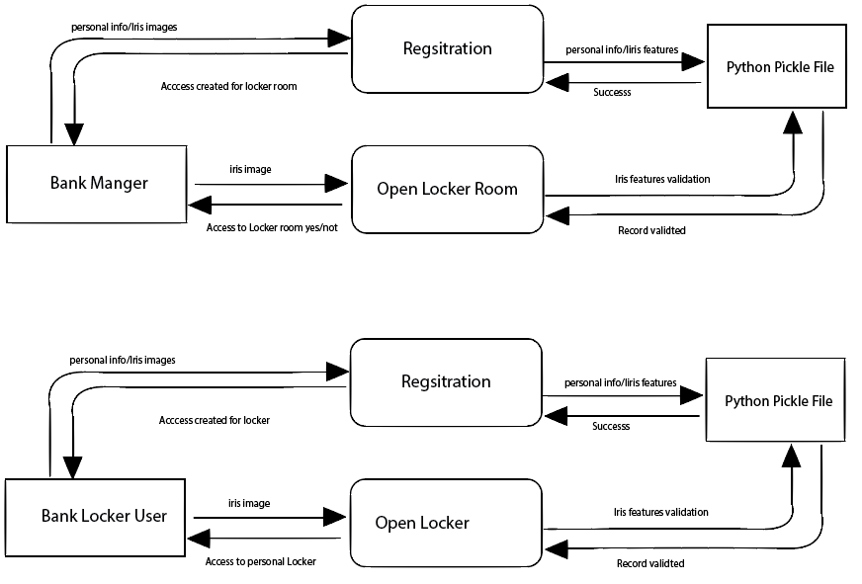
DFD (Level 1)

Slide 18
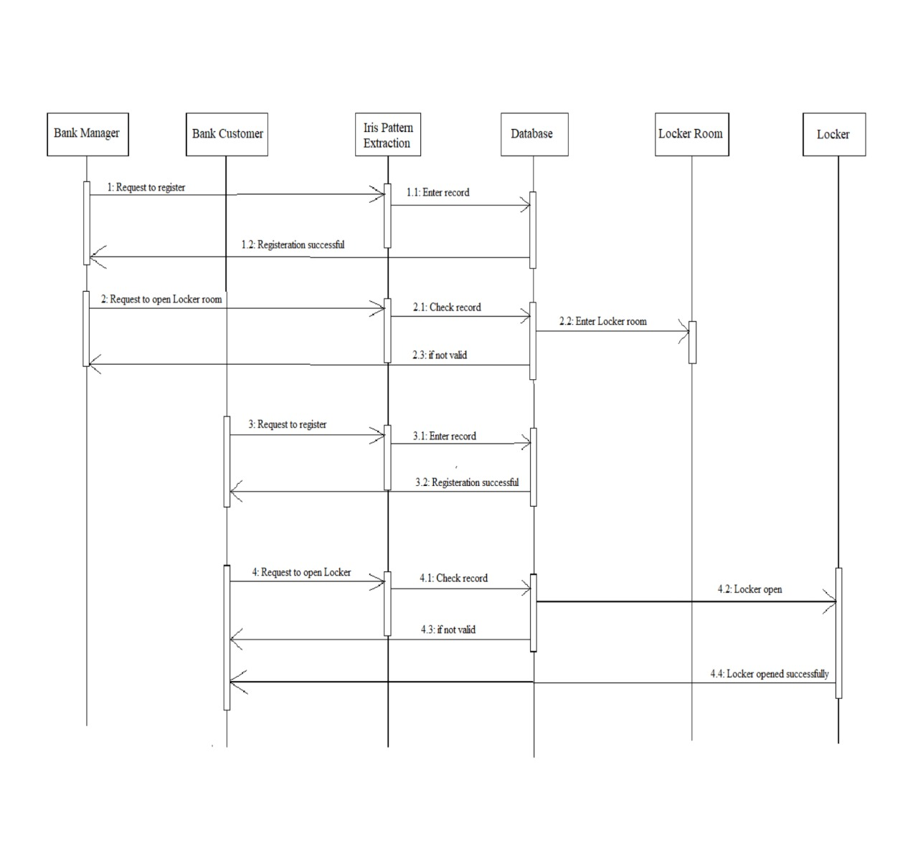
Sequence Diagram

Slide 19
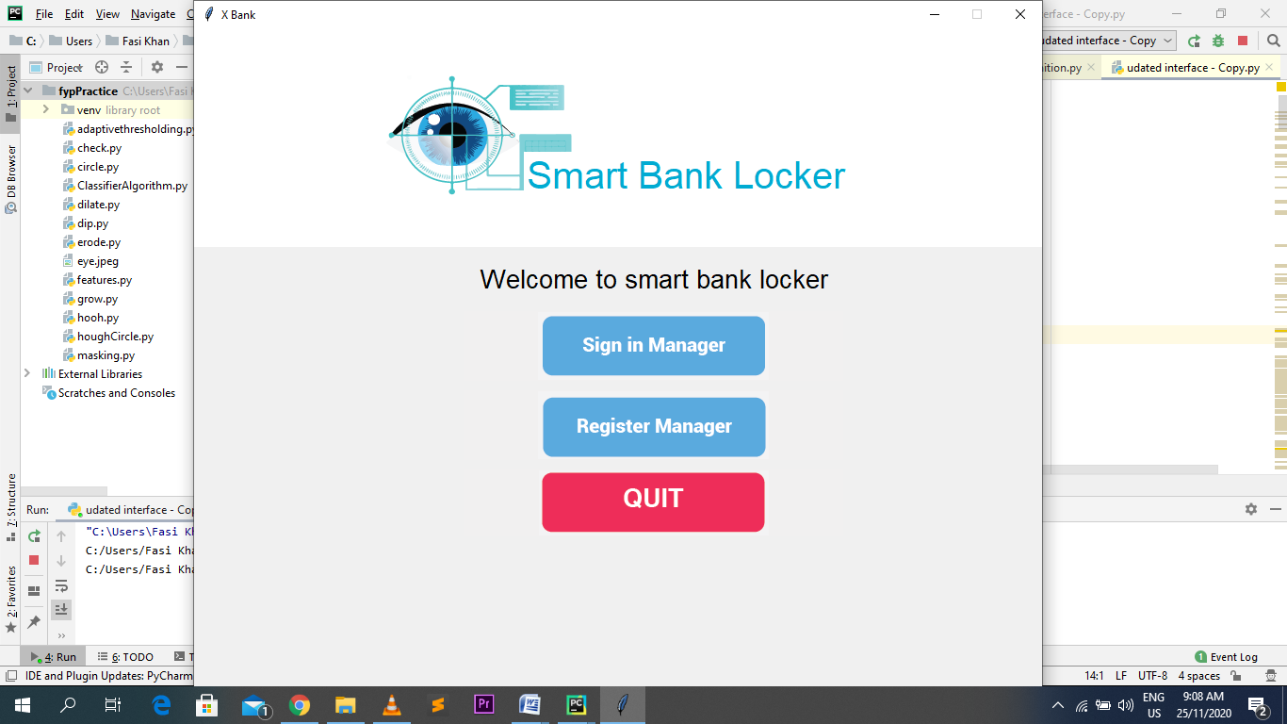
System Screenshots

Slide 20
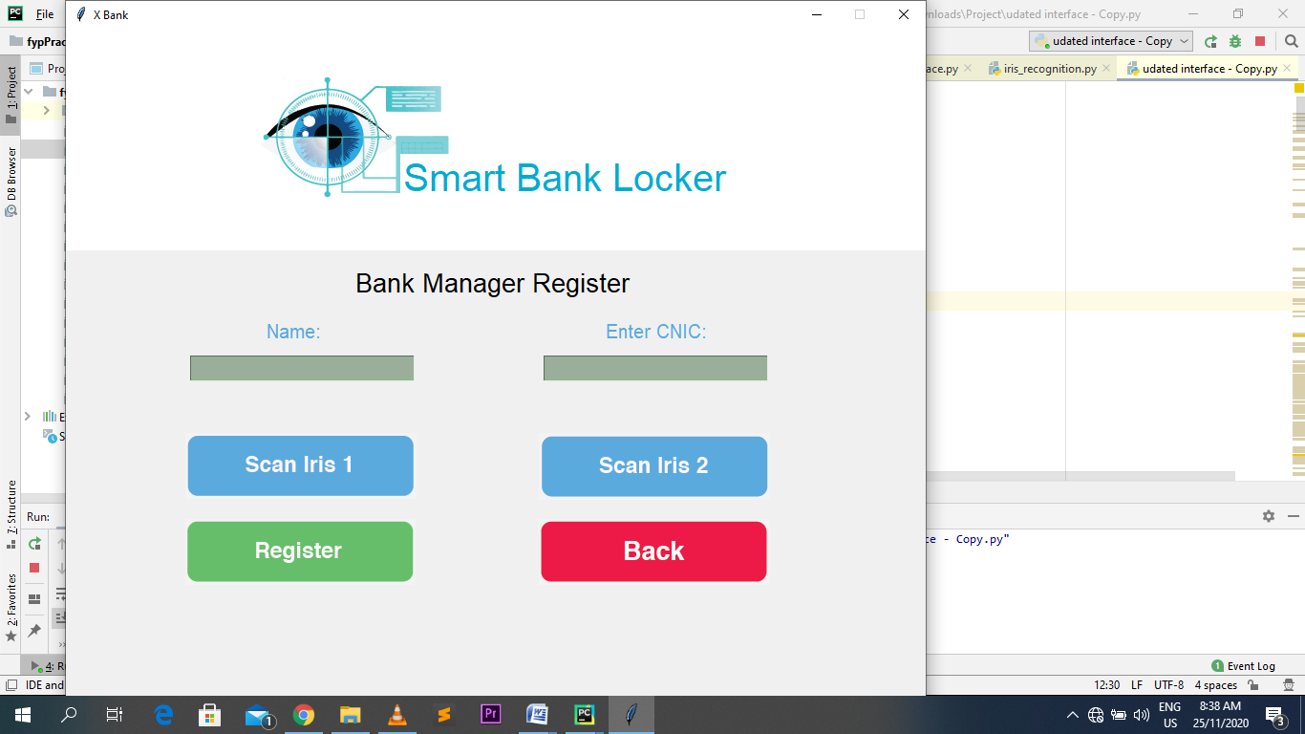
System Screenshots

Slide 21
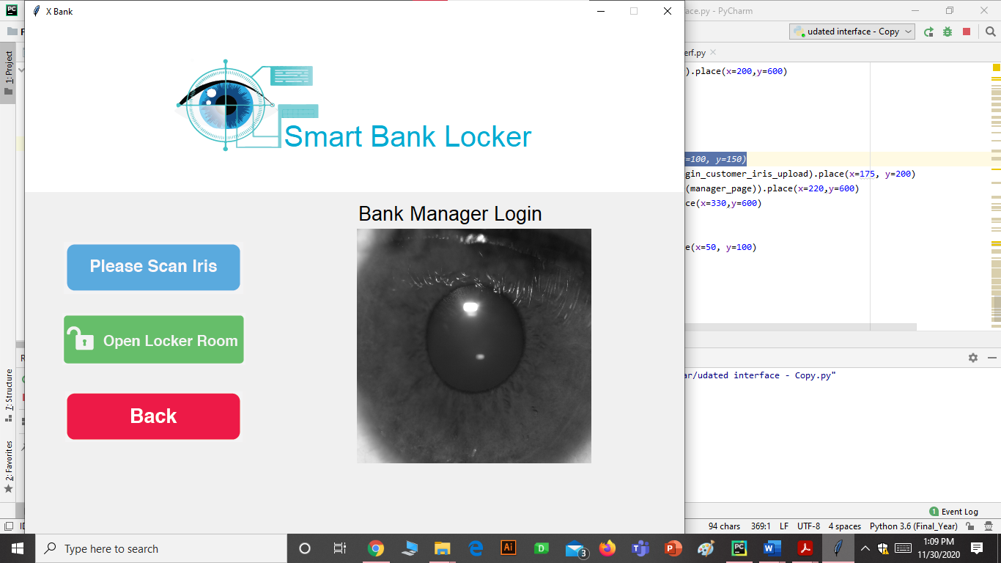
System Screenshots

Slide 22
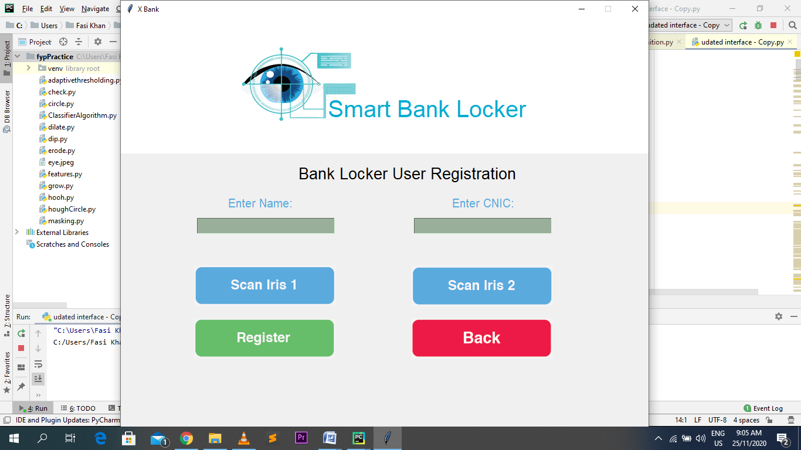
System Screenshots

Slide 23
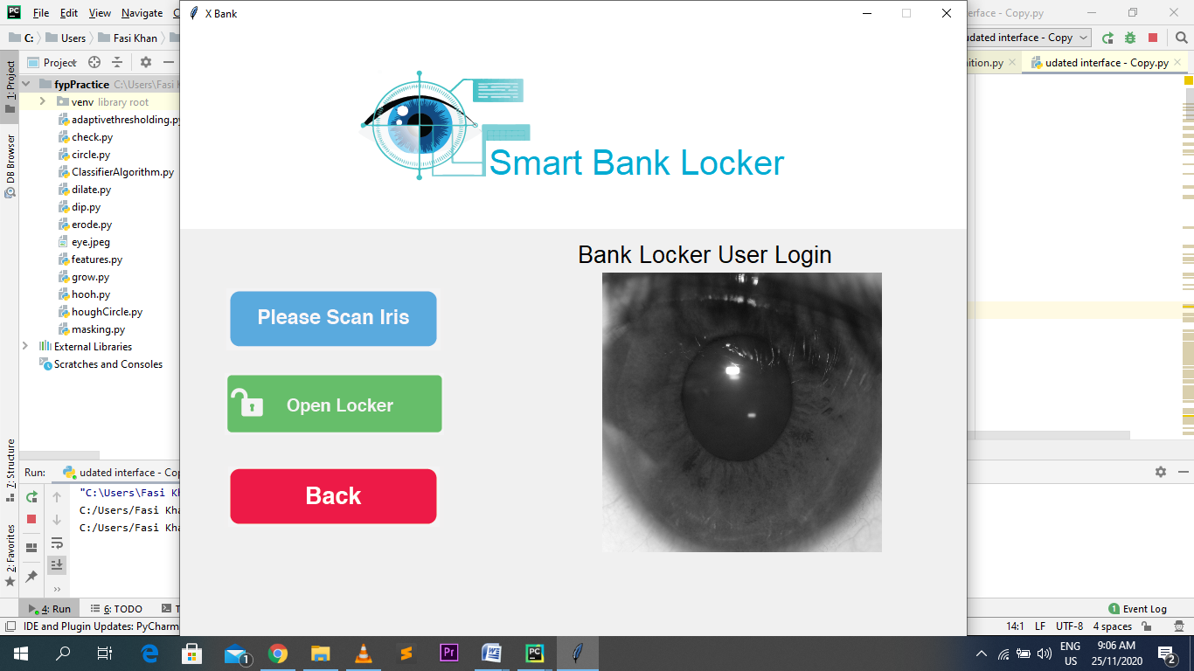
System Screenshots

Slide 24
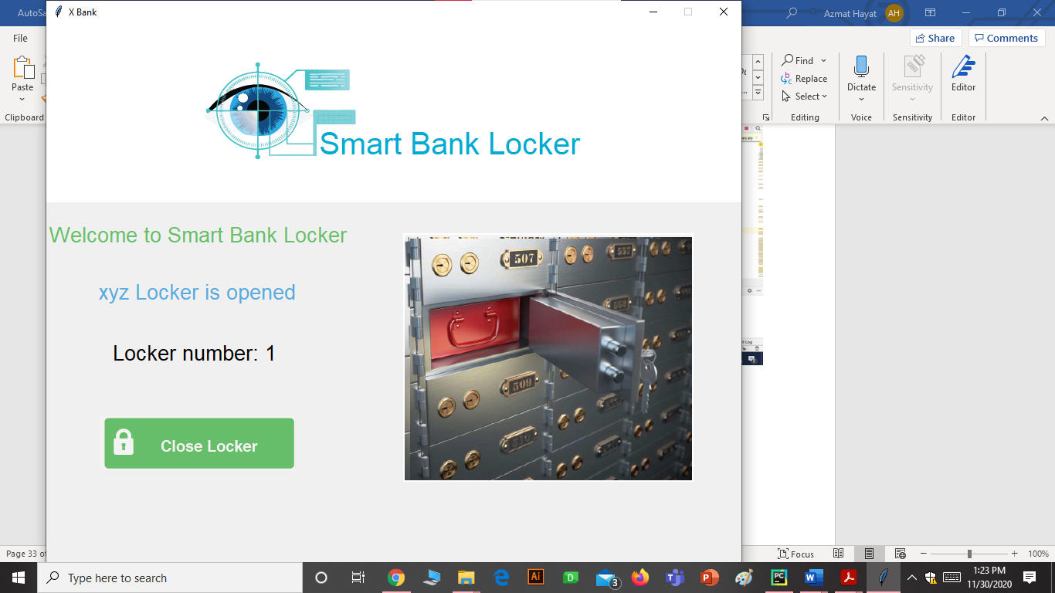
System Screenshots

Slide 25
Conclusion and Future Work
Fully automatic security system for bank lockers.
As each person has unique iris pattern hence it ensures total genuine access of the locker.
It provide better speed and scalability
Misuse and frauds in banks can be reduced to greater amount
Manual mistakes get reduces.

Slide 26
Continued...
In future system has capacity to add up a fingerprint to provide hybrid security and feasibility in use.
Incase if some one unable to provide one biometric identity than can be easy to use another one.
In case of any accident happen and person lost his/her finger or eye than hybrid feature allow to use any one of biometric

Slide 27
Thank You
Any Question?

